Slide 1
Breast Cancer Risk Prediction
- MENAKA ALAGAR

Slide 2
Breast Cancer Risk Prediction
This project aims to enhance the understanding of breast cancer prognosis and refine prediction models for patient outcomes. By utilizing advanced statistical methods and machine learning techniques, the project seeks to analyze survival trends and accurately predict long-term survival rates for breast cancer patients.
Project Objectives
Survival Analysis: Use models like the Kaplan-Meier survival curve and Cox Proportional Hazards model to analyze survival trends and identify significant factors impacting survival.
Prediction of 10-Year Mortality: Build a machine learning model to predict the likelihood of a patient surviving or passing away within 10 years of diagnosis.
Insights into Treatment and Research: Identify critical factors influencing survival to optimize treatment strategies and guide future research.

Slide 3
Introduction
Breast Cancer refers to a malignant tumor that develops from the cells of the breast and is one of the leading causes of cancer-related deaths in women. Early detection and predictive models in healthcare can assist doctors in identifying potential risks before they escalate.
This dataset offers a detailed analysis of various patient health indicators, focusing specifically on factors related to breast cancer risk.
Comprehensive data visualizations illustrating survival relationships with various factors like age, tumor size, and treatments.
A comparative analysis of machine learning models (e.g., Logistic Regression, SVM, Decision Trees) to evaluate which performs best.

Slide 4

Survival Analysis
STEP
Use models like the Kaplan-Meier survival curve and Cox Proportional Hazards model to analyze survival trends
07
Model Evaluation
STEP
06
Assessing the performance of a machine learning model using metrics
Model Selection and
Model Training
STEP
Choosing a suitable machine learning algorithm and optimizing its parameters
05
Split Train And Test Data
WORK FLOW
WORK FLOW
STEP
04
Dividing the dataset into training and testing sets to evaluate
PREPROCESSING
STEP
Preparing and cleaning data to enhance its quality and suitability
03
Exploratory Data Analysis
STEP
02
Analyzing and visualizing data patterns to understand its characteristics
Data Collection
STEP
Gathering and organizing data to train machine learning models.
01

Slide 5
Data Collection
The dataset is collected from Kaggle. Kaggle is one of the largest platforms for accessing high-quality datasets for machine learning, data science, and analytics projects. It offers a variety of datasets contributed by the community, organizations, or researchers.
Number of Entries: The dataset consists of 2509 entries, ranging from index 0 to 2508.
Columns: There are 34 columns in the dataset corresponding to various attributes of the patients .
Data types:
Most of the columns (34 out of 24) are the object data type.
Remaining column is the float64 data type.
Missing Values: There is lot of missing values treating them by Simple Imputer using most frequent values.

Slide 6
EXPLORATORY DATA ANALYSIS
Exploratory Data Analysis (EDA) helped us understand the data structure, find patterns, identify trends, and gain valuable insights from the dataset.
From EDA we analyze, the distribution of each features, checking the correlation between the features .
Using visuals helped us see the data clearly, understand the clinical data relationship with each other, and pinpoint factors that plays vital role in predictions of Breast Cancer.
The datasets has NULL VALUE and DUPLICATE VALUES.

Slide 7
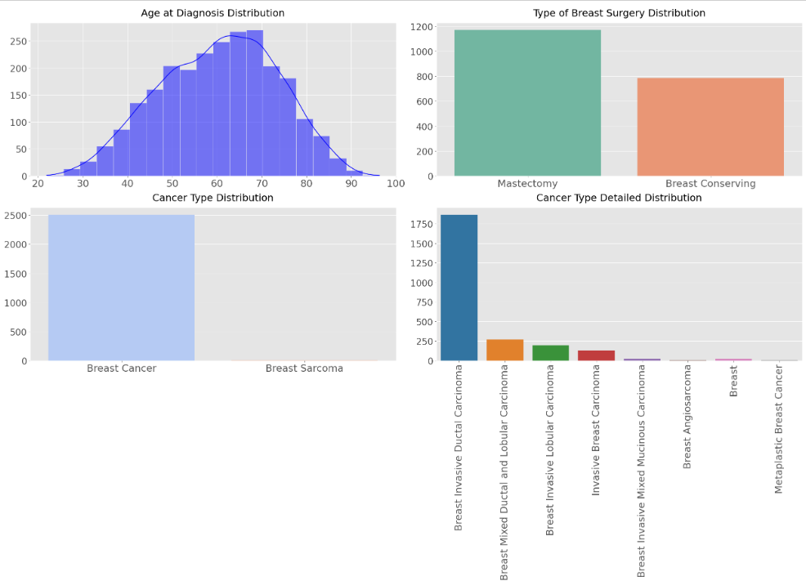
UNIVARIATE ANALYSIS

Slide 8
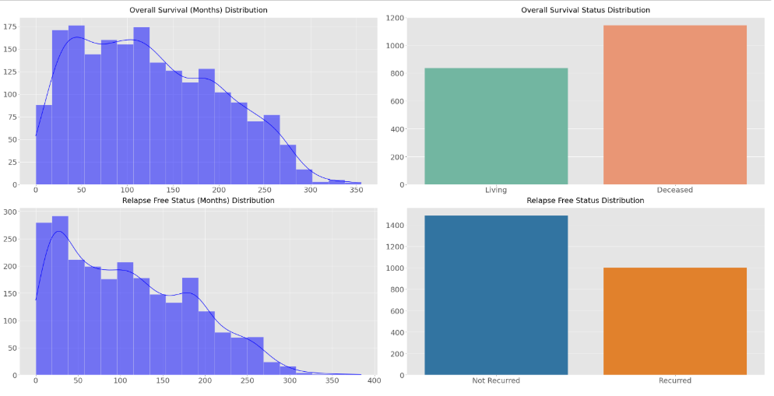
UNIVARIATE ANALYSIS

Slide 9
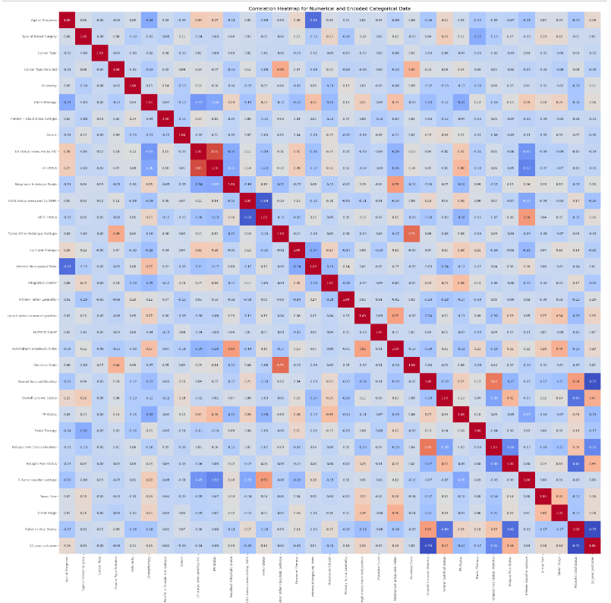
Correlation of HeatMap

Slide 10
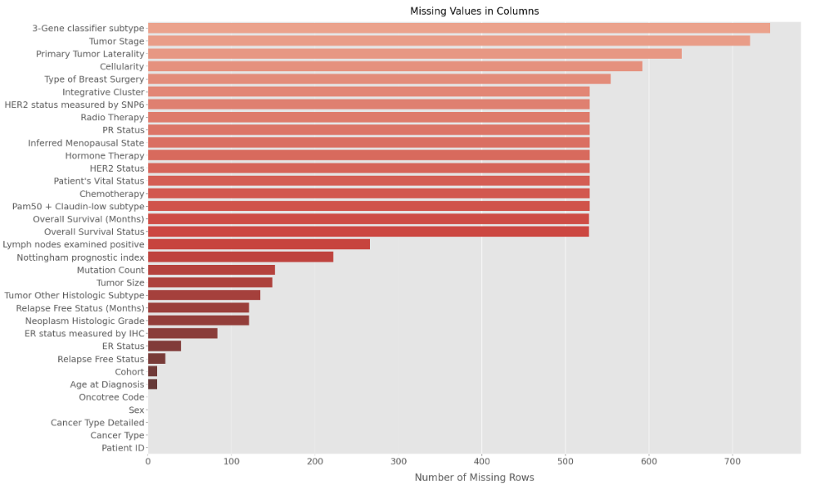
Bar chart for Missing Values
Here there is lot of missing values in the dataset.
Mostly 3-Gene Classifier subtype and Tumor stage has lot of missing values
Cohort and Age at Diagnosis has less number of missing values.
Here we are treating missing values by most frequent values using SimpleImputer.

Slide 11
Pre-Processing
Irrelevant Feature Removal: Some Features from dataset to be irrelevant like [Patient ID and Sex] these features are removed from the dataset
Missing Value Treatment: There is some missing values in the dataset so we treating them by most frequent values using SimpleImputer.
Duplicate Values removal: There are few duplicate value in the dataset so removing duplicate values is important.
TRAIN-TEST SPLIT
We divided the data into training (80%) and testing (20%) sets.
Setting a random state ensures consistent results and using stratify=y maintains a proportional distribution of the target variable in both sets.
We divided the dataset into two parts: X and y.
"X" typically represents the independent Variables, and "y" represents the Dependent (target variable) that we want to predict or understand.

Slide 12
Model Selection
Models used
Logistic Regression: logistic Regression is commonly used for binary classification problems. it's preferred because it provides a simple an efficient way to model the relationship between the independent variables and the probability of a certain outcome.
Decision Tree: Decision Tree algorithms are used for classification because they are simple, computationally efficient, and effective in handling high-dimensional data. Works best for categorical independent columns.
Support Vector Machine: SVM is a powerful supervised algorithm that works best on smaller datasets but on complex ones. Support Vector Machine(SVM)can be used for both regression and classification tasks, but generally, they work best in classification problems.

Slide 13
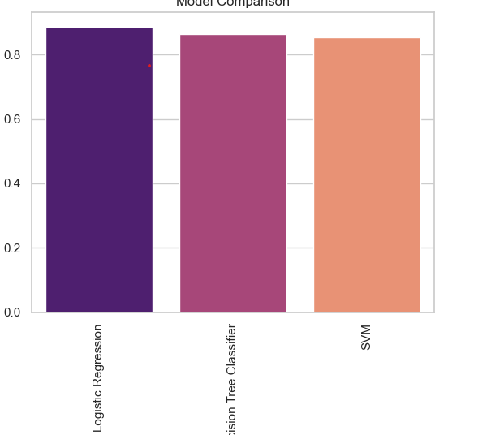

Accuracy %
Recall %
F1 Score %
Logistic Regression | 88 | 90 | 92 | 91
Decision Tree | 86 | 91 | 86 | 88
Support Vector Machine | 85 | 93 | 82 | 87
Precision %
Experimental Results :
Logistic regression: LR achieves 88% accuracy, precision (90%) and recall (92%).
Decision Tree Consistency: maintains 86% accuracy, Recall (86%) and precision(91%)
SVM : Support Vector Machine achieves 85% accuracy, precision (93%) and
recall (82%)

Slide 14
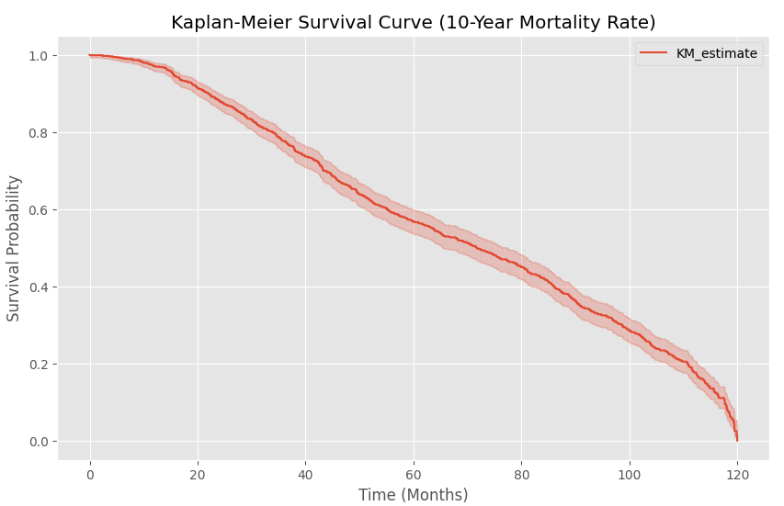
Kaplan-Meier Survival
The Kaplan-Meier method calculates and plots the survival curve.
This graph visually communicates survival trends for the studied population over 10 years.
The survival probability decreases steadily over time, showing the proportion of individuals who survived decreases as time progresses.
At the 120-month (10-year) mark, the survival probability approaches 0, indicating very few individuals remain alive.

Slide 15
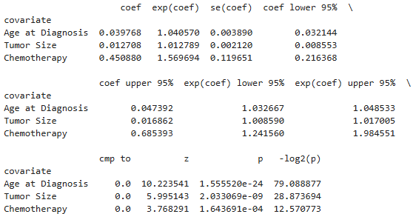
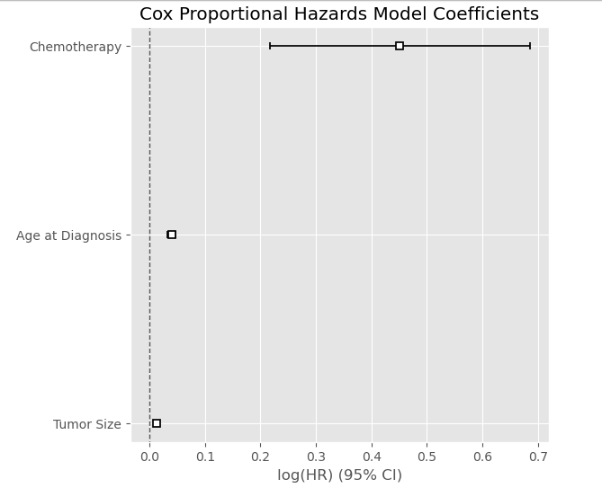
Cox Proportional Hazard
A Cox Proportional Hazards Model, a statistical model used in survival analysis
Variables being analyzed in the model (e.g., Age at Diagnosis, Tumor Size, and Chemotherapy).
The estimated coefficient for each covariate. A positive coef indicates that the variable increases the hazard (risk of death), while a negative coef decreases the hazard.
Age at Diagnosis and Tumor Size have small but statistically significant effects.
Chemotherapy is associated with an increased hazard but has greater variability.

Slide 16
Conclusion
Key Findings
The results indicated that the Random Forest classifier model had the higghest accuracy of 95%.
The study utilized the kaggle Breast Cancer prediction(METABRIC) dataset with 2509 instances and 34 columns, all algorithms were implemented on Jupyter Notebook.
The accuracies of all algorithms were above 94% with the lowest accuracy of 79% given by Support Vector Machine and the highest accuracy given Random Forest Classifier as previously mentioned.
Future Research
Future research must ensure robustness, generalizability, and interpretability for informed decision-making based on study findings. It's important to check how duplicate data and unusual values affect the model's accuracy. Creating strategies to deal with these issues is valuable for improving model performance.

Slide 17
Thank You!

